Slide 1

Handling issues of The CyberWorld and
Stamp chat
Ruchita Raut 19104033
Ayush Jain 18104005
Sakshi Shinde 19104055
Project Guide
Prof. Jayashree Jha
Notes:
‹#›

Slide 2
Contents
Introduction
Objectives
Solution Method
Project Outcomes
Technology Stack
Notes:
‹#›

Slide 3
1. Introduction
Stamp Chat - Secure open source communication platform that ensures messages can never be read by third parties.
Problem Identified :
Scroll to bottom without rendered images
Solution Proposed :
New library will load images faster one by one on scrolling down the chat.
Notes:
‹#›

Slide 4
2. TheCyberWorld - The Thecyberworld is a community that help people to contribute to open source and arrange events for the developers, so that developers can be able to explore the other projects.
Problem Identified :
Unable to display the real-time date for events.
Solution Proposed :
Create a FormatDate function for sequencing the Date format.
Notes:
‹#›

Slide 5
2. Objectives
Stamp Chat
To make the navigation process fast
To save time to load the images
To increase the efficiency of site
2. TheCyberWorld
To get the real-time data of upcoming and ongoing events.
To give the up-to-date schedule of competitions.
Notes:
‹#›

Slide 6
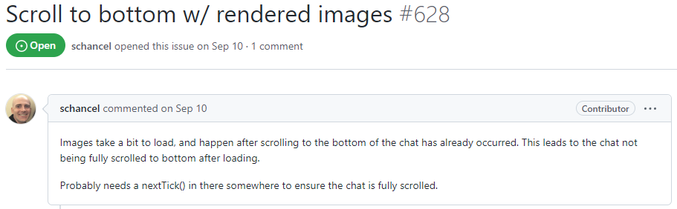
3. Solution Method
Stamp chat
fig 3.1 StampChat issue raised
Notes:
‹#›

Slide 7
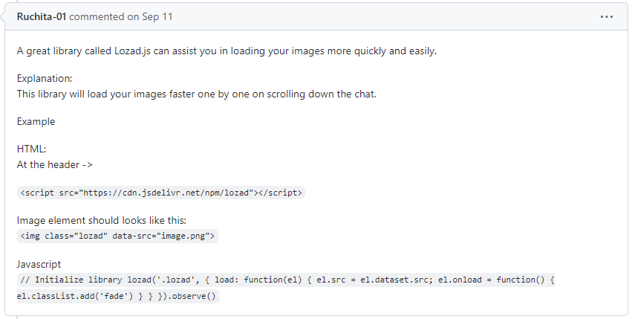
1. Stamp chat
Fig 3.2 Solution for the issue
Notes:
‹#›

Slide 8
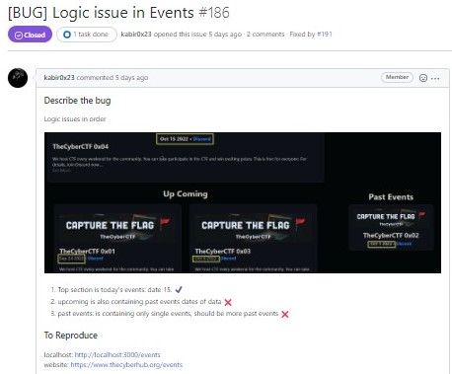
2. CyberWorld
fig 3.3 TheCyberWorld Issue
Notes:
‹#›

Slide 9
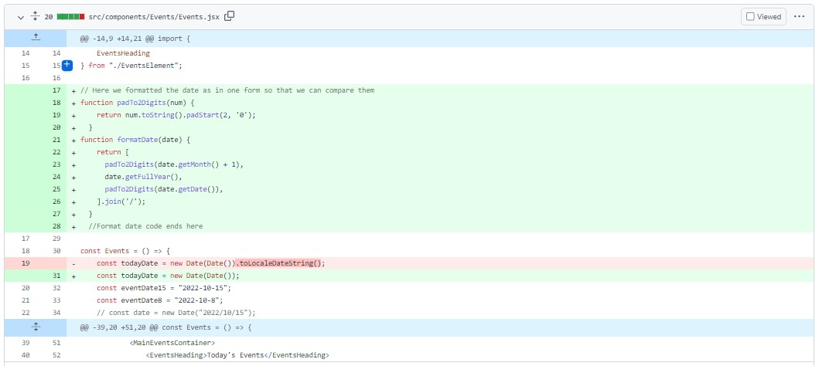
2. CyberWorld
fig 3.4 Code Change after commit TheCyberworld
Notes:
‹#›

Slide 10
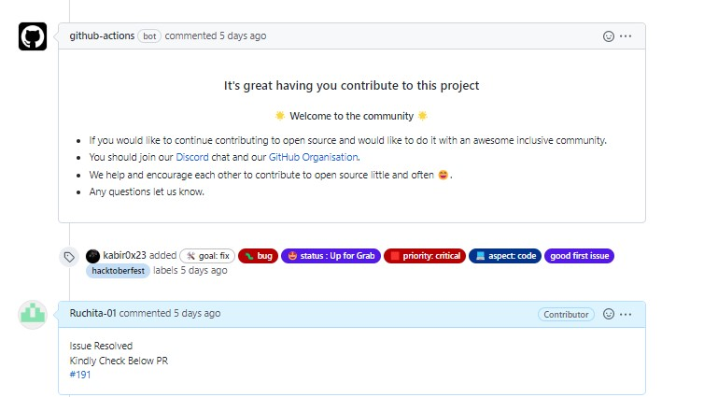
2. CyberWorld
fig 3.5 Contribution Accepted by the Website Developer
Notes:
‹#›

Slide 11
5. Technology Stack
- HTML
- CSS
- Javascript
Notes:
‹#›

Slide 12
4. Outcome of Project
Stamp chat
User can easily scroll down the chat
User can easily load the images while scrolling
2. CyberWorld
To get the real-time data of upcoming and ongoing events.
To give the up-to-date schedule of competitions.
Notes:
‹#›

Slide 13
Thank You...!!
Notes:
‹#›

